Slide 1
Introduction to Separation

Slide 2
By the end of this lesson you should be able to:
1. | List examples of mixtures and separation techniques that are used in everyday life.
2. | Describe the methods used to decant and strain substances.
3. | Compare decanting and straining.

Slide 3
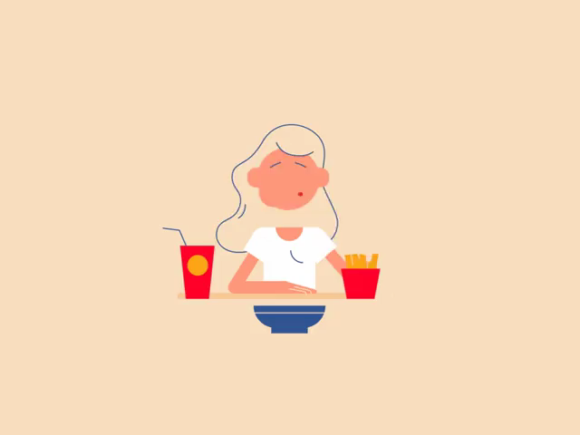
Mixtures, both natural and man-made, surround us in our daily lives.
Our food, drinks, bodies and more are all made up of lots of different types of small particles.
Some situations call for removing specific types of particle from a mixture. Removing these particles is called "separation".

Slide 4
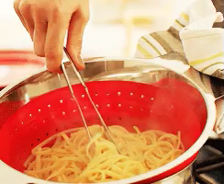
For example, pasta cooking in boiling water is a suspension.
To get the cooked pasta out, you need to separate the suspension into pasta and water.
To do this you use a sieve or drain the water off with the lid.

Slide 5
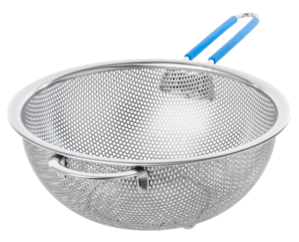
Both of these processes (using a sieve or draining the water) are examples of two different ways to separate mixtures.
They are called sieving and decanting respectively.

Slide 6
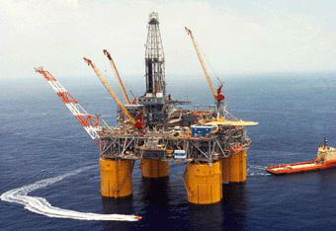
Many industries focus on separating mixtures into their parts.
Crude oil is a mixture of many different chemicals. The oil industry has to use many different techniques to extract the useful chemicals.

Slide 7
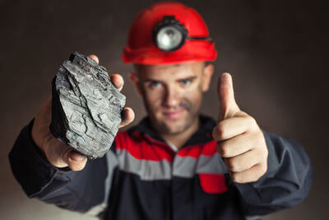
Mining extracts metals from the ground - but most metals are trapped in ores (eg. iron in iron ore) and must be separated to be useful.

Slide 8
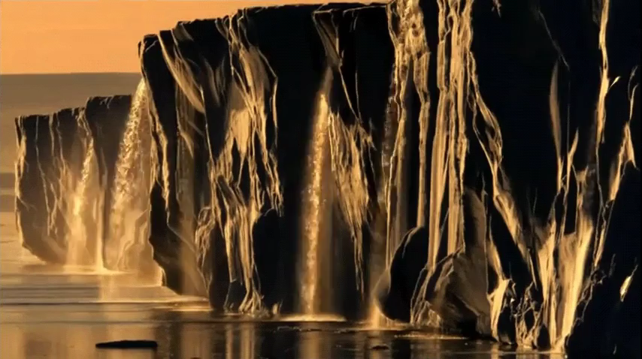
Also, water found in lakes, rivers and oceans is often unable to be consumed and used safely.
We use separation techniques to clean water and make it useful.
Therefore, separation is a very important process to learn about because it has many applications in our lives.

Slide 9
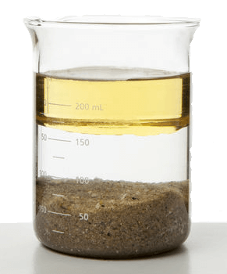
One of the simplest ways to separate a suspension is to let it settle over time.
This is called gravity separation.
Heavier parts of a suspension sink to the bottom, and lighter parts float to the top. This creates layers of separated material. It is now simple to take one part away to be used elsewhere.

Slide 10
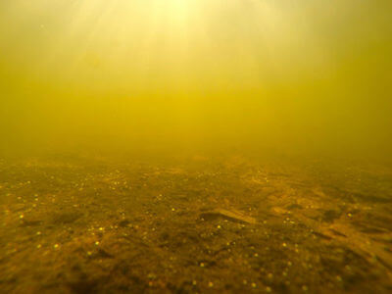
When a suspension contains a solid part that settles to the bottom, we call this sedimentation.
The solid particles that settle are called sediment.
This is what happens in the ocean - suspended dirt, sand, and dead animals settle to the bottom of the sea over time.

Slide 11
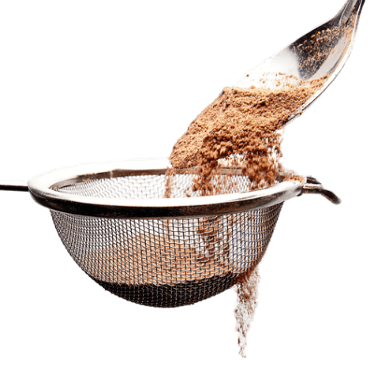
Straining, or sieving, is a separation method that removes liquid through the bottom of the container, leaving the solid behind.
It is used when the solid part of the suspension has large particles.
Containers are designed specifically for this purpose; colanders are used to remove water from food and storm drains are used to remove rubbish from water.

Slide 12
Decanting is the process of removing the liquid part from a suspension.
If a suspension is made of two liquids, one liquid will be lighter than the other and will float.
If a suspension is a solid and a liquid, then the solid will usually be heavier than the liquid, and will sink to the bottom.

Slide 13

To decant is to remove one part of the suspension.
The easiest parts to remove are the liquids. This can be done by carefully pouring the top layer off. This leaves the rest of the mixture in the container.
However, this method is not very precise.

Slide 14
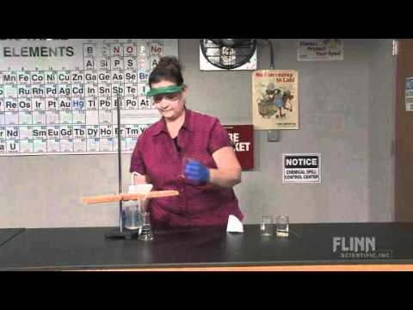

Slide 15
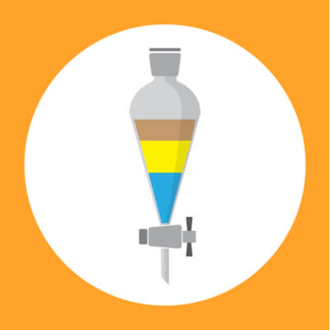
Chemists use a separatory funnel to decant suspensions.
As you can see in the image below, a separatory funnel is a piece of glassware with a tap at the bottom.
Liquids are placed in the funnel and allowed to form layers. The bottom layer can then be removed by opening the tap, and closing it again so that all of the bottom layer is removed.

